Slide 1

Team 3: HARRY & HENDERSONS
Dan Davies, Stefanie Gagnon, Chris Partee, Khanh Le

Slide 2
agenda
Data overview
Data Analysis and Visualizations
findings

Slide 3

Data over view

Slide 4
Data overview
This data was derived from data provided by the Bigfoot Field Research Organization (BFRO)
BFRO is an organization dedicated to investigating the bigfoot / sasquatch mystery.
This dataset shows the approximate locations of bigfoot sightings.

Slide 5
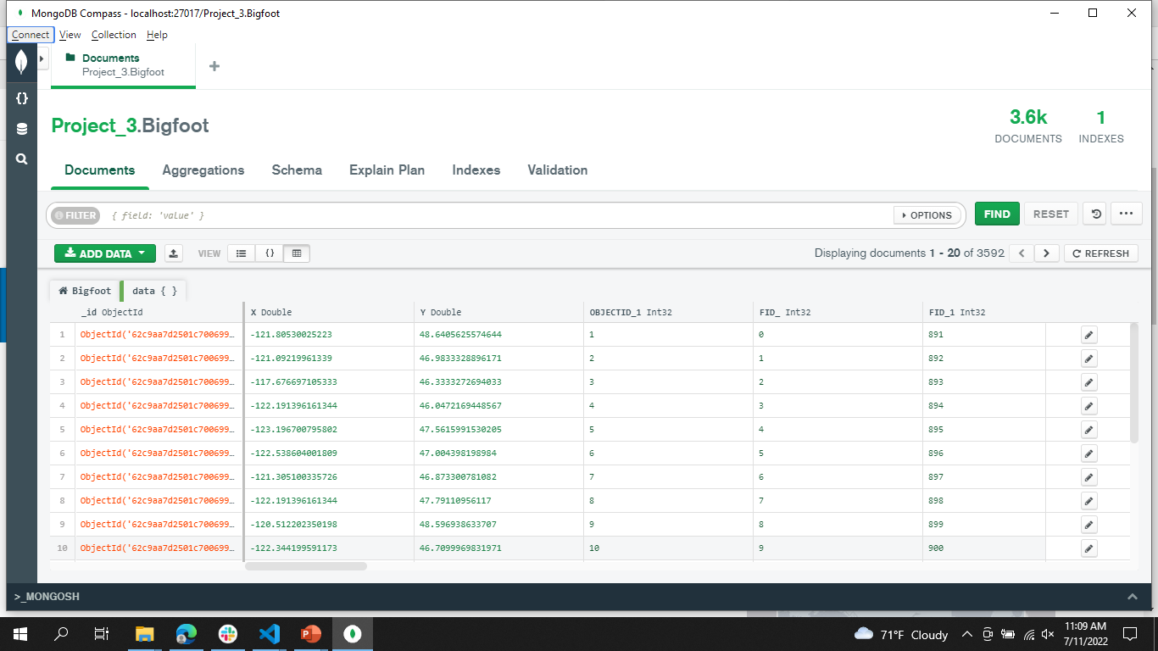
Data overview

Slide 6
Data Analysis and Visualizations

Slide 7
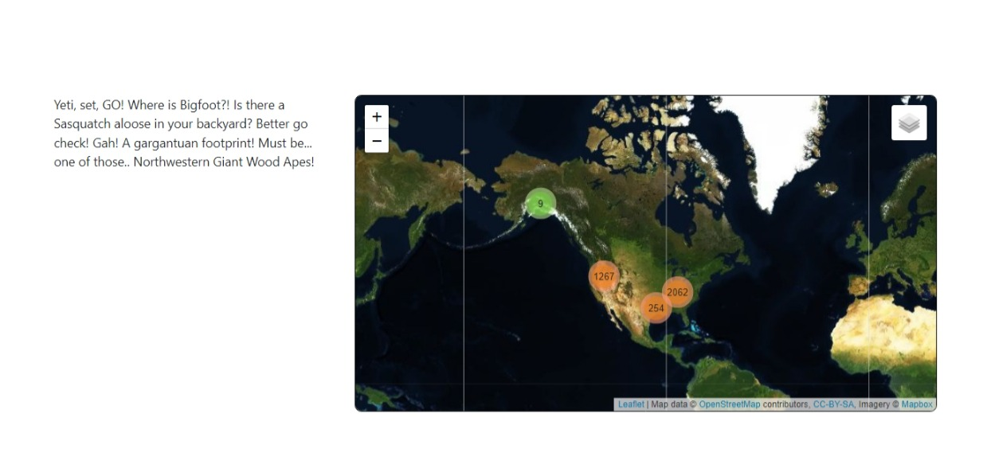
Data Analysis and Visualizations

Slide 8
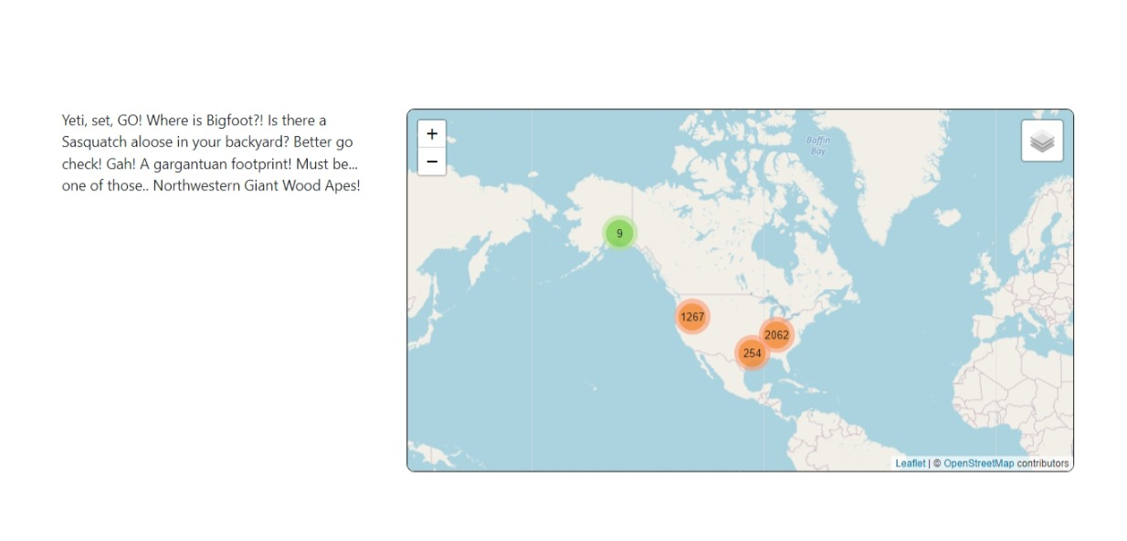
Data Analysis and Visualizations

Slide 9
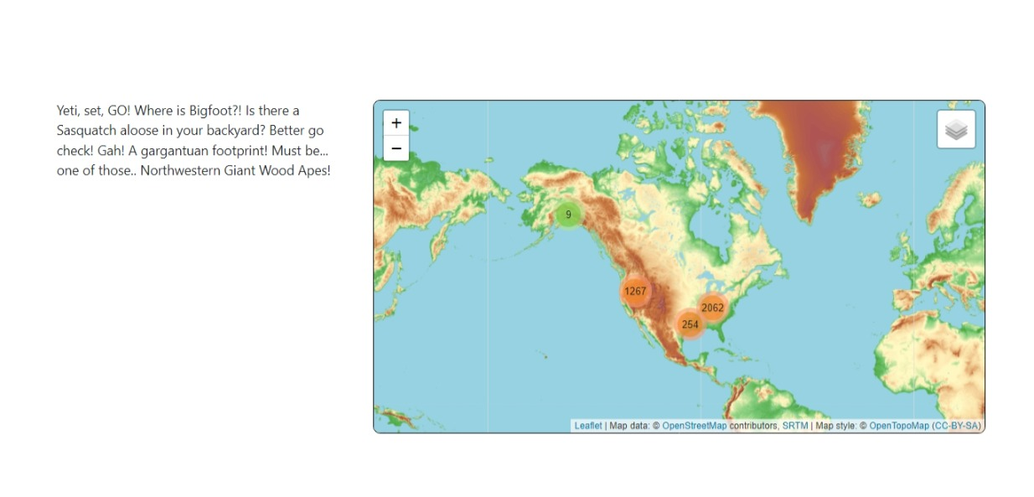
Data Analysis and Visualizations

Slide 10
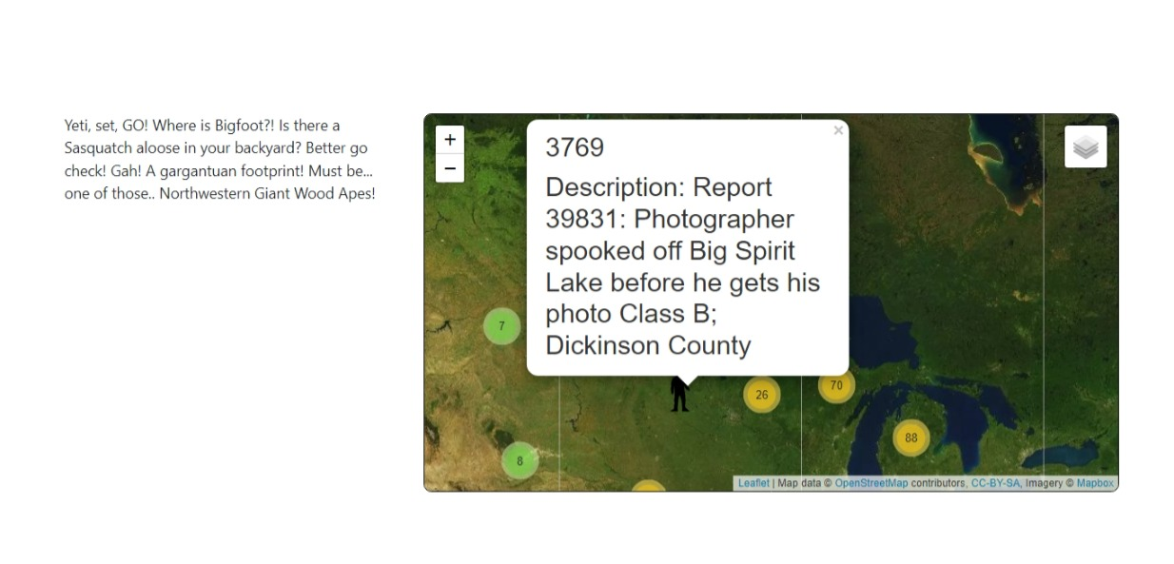
Data Analysis and Visualizations

Slide 11
findings

Slide 12
findings

Slide 13
findings

Slide 14
Limitations & questions for further exploration

Slide 15
References:
https://hub.arcgis.com/datasets/TrainingServices::-bigfoot-sightings/explore?location=27.848424%2C-103.774481%2C4.00
https://data.world/timothyrenner/bfro-sightings-data

Slide 16
Thank you

